Slide 1
CSE477
VLSI Digital Circuits
Fall 2002
Lecture 17: Static Sequential Circuits
Mary Jane Irwin ( www.cse.psu.edu/~mji ) www.cse.psu.edu/~cg477
[Adapted from Rabaey’s Digital Integrated Circuits, ©2002, J. Rabaey et al.]

Slide 2
Review: How to Choose a Logic Style
Must consider ease of design, robustness (noise immunity), area, speed, power, system clocking requirements, fan-out, functionality, ease of testing
4-input NAND
Style | # Trans | Ease | Ratioed? | Delay | Power
Comp Static | 8 | 1 | no | 3 | 1
CPL* | 12 + 2 | 2 | no | 4 | 3
domino | 6 + 2 | 4 | no | 2 | 2 + clk
DCVSL* | 10 | 3 | yes | 1 | 4
* Dual Rail
Current trend is towards an increased use of complementary static CMOS: design support through DA tools, robust, more amenable to voltage scaling.
Notes:
Current trend is towards an increased use of complementary static CMOS - tools driven that emphasis optimization at the logic level rather than the circuit level and that put a premium on robustness.
Static CMOS is also more amenable to voltage scaling than some of the other approaches.

Slide 3
A time was probably coming when components would operate so quickly that the distance that signals had to travel would intimately affect the speed of most commercial computers. Then miniaturization and speed would become more nearly synonymous.
The Soul of a New Machine, Kidder, pg. 160

Slide 4
Sequential Logic
Inputs
Outputs
Combinational
Logic
Current
State
Next
State
State
Registers
clock
Notes:
Output is a function of the inputs AND the current state
Have already discussed how to design the combinational logic part – now need to focus on designing the state registers
Mealy (both the input and the current state is used to determine the output) versus Moore state machines (output depends only on the current state). Moore machines have potential implementation advantages in speed and size – speed because the control outputs, which are needed early in the clock cycle, do not depend upon the inputs. Moore machine disadvantages are that they may require additional states.
The State Register shown is “edge-triggered” (can tell by the >). In fact, its positive edge triggered, i.e., changes output state when the clock edge goes from 0 to 1 (can tell by the absence of a o)

Slide 5
Timing Metrics
In
D
Q
Out
clock
clock
t_{su}
t_{hold}
time
In
data
stable
t_{c-q}
time
Out
output
stable
output
stable
time
Notes:
tsetup – time that the data inputs (D) must be valid before the clock transition (0 ti 1 transition for a positive edge-triggered device)
thold is the time that the data inputs must remain valid after the clock edge
Tc-q is the worst case propagation delay (with reference to the clock edge) – time to copy D to Q

Slide 6
System Timing Constraints
Inputs
Outputs
Combinational
Logic
Current
State
Next
State
State
Registers
T (clock period)
clock
t_{cdreg} + t_{cdlogic} ≥ t_{hold}
T ≥ t_{c-q} + t_{plogic} + t_{su}
Notes:
contamination delay - minimum delay of the combinational logic or register
Thus, it is important to minimize the values of the timing parameters associated with the register. In modern high-performance systems, the register propagation delay and set-up times account for a significant portion of the clock period. E.g., DEC Alpha EV6 has a maximum logic depth of 12 gates and the register overhead accounts for about 15% of the clock period.
Hold time becomes and issue then there is little logic between registers or when the clocks at different registers are somewhat out of phase due to clock skew.
Modern machines are characterized by a very-low logic depth and, in fact, the register propagation delay and setup times account for a significant portion of the clock period. E.g., DEC EV6 has a maximum logic depth of 12 gates and the register overhead accounts for approx. 15% of the clock period.

Slide 7
Static vs Dynamic Storage
Static storage
  preserve state as long as the power is on
  have positive feedback (regeneration) with an internal connection between the output and the input
  useful when updates are infrequent (clock gating)
Dynamic storage
  store state on parasitic capacitors
  only hold state for short periods of time (milliseconds)
  require periodic refresh
  usually simpler, so higher speed and lower power
Notes:
clock gating - conditional clocks - where the clock is turned off for unused modules to save on power

Slide 8
Latches vs Flipflops
Latches
  level sensitive circuit that passes inputs to Q when the clock is high (or low) - transparent mode
  input sampled on the falling edge of the clock is held stable when clock is low (or high) - hold mode
Flipflops (edge-triggered)
  edge sensitive circuits that sample the inputs on a clock transition
    positive edge-triggered: 0 → 1
    negative edge-triggered: 1 → 0
  built using latches (e.g., master-slave flipflops)
Notes:
Positive latch - can also have negative latch with flip definitions
Should insert a slide with figure 7.3 after this one?

Slide 9
Review: The Regenerative Property
V_{i1}
V_{o1}
V_{i2}
V_{o2}
cascaded inverters
A
If the gain in the transient region is larger than 1, only A and B are stable operation points. C is a metastable operation point.
V_{i2} = V_{o1}
C
B
V_{i1} = V_{o2}
Notes:
bistability principle - a circuit having two stable states that represent 0 and 1
Consider just two inverters - VTC of first inverter and second inverter (later plot is rotated to accentuate that Vi2 = Vo1). Resulting circuit has just three possible operation points (A, B and C). A small deviation from the bias point C (e.g., from noise) is amplified and regenerated around the circuit loop until either point A or B is reached.
A and B are stable operation points. At these points, the loop gain is much smaller than unity.

Slide 10
Bistable Circuits
The cross-coupling of two inverters results in a bistable circuit (a circuit with two stable states)
V_{i1}
V_{i2}
Have to be able to change the stored value by making A (or B) temporarily unstable by increasing the loop gain to a value larger than 1
  done by applying a trigger pulse at V_{i1} or V_{i2}
  the width of the trigger pulse need be only a little larger than the total propagation delay around the loop circuit (twice the delay of an inverter)
Two approaches used
  cutting the feedback loop (mux based latch)
  overpowering the feedback loop (as used in SRAMs)
Notes:
cutting the feedback loop is the most popular in today’s latches

Slide 11
Review (from CSE 271): SR Latch
S | R | Q | !Q
0 | 0 | Q | !Q | memory
1 | 0 | 1 | 0 | set
0 | 1 | 0 | 1 | reset
1 | 1 | 0 | 0 | disallowed
S
!Q
Q
R

Slide 12
Review (from CSE 271): Clocked D Latch
D
!Q
Q
D
D Latch
Q
clock
transparent mode
clock
clock
hold mode

Slide 13
MUX Based Latches
Change the stored value by cutting the feedback loop
feedback
feedback
1
0
Q
Q
D
0
D
1
clk
clk
Negative Latch
Positive Latch
Q = clk & Q | !clk & D
Q = !clk & Q | clk & D
transparent when the clock is low
transparent when the clock is high
Notes:
Nonratioed latch – sizing of the devices affects performance and is not critical to functionality

Slide 14
TG MUX Based Latch Implementation
clk
Q
!clk
input sampled
(transparent mode)
D
clk
clk
D
D Latch
Q
!clk
clk
feedback
(hold mode)
Notes:
Positive latch – latch is transparent (D is copied to Q) when clk is high (bottom transmission gate is on)
clk load is two transistors (and two for !clk) = clock load of 4
Also have the problem of having to generate both clk and !clk (nonoverlapping clocks)

Slide 15
PT MUX Based Latch Implementation
clk
!Q
D
Q
input sampled
(transparent mode)
!clk
Reduced clock load, but threshold drop at output of pass transistors so reduced noise margins and performance
clk
!clk
feedback
(hold mode)
Notes:
Positive latch – latch is transparent (D is copied to Q) when clk is high
Have reduced clock load by replacing transmission gates with pass transistors, but that impacts both noise margin and switching performance and causes static power dissipation due to threshold drop.
clk load is one transistors (and one for !clk) = clock load of 2
Still have the problem of having to generate both clk and !clk

Slide 16
Latch Race Problem
Combinational
Logic
B
B
B’
State
Registers
clk
Which value of B is stored?
clk
Two-sided clock constraint
T ≥ t_{c-q} + t_{plogic} + t_{su}
T_{high} < t_{c-q} + t_{cdlogic}
Notes:
So, a solution to the latch race problem is to design with edge-triggered (master-slave) devices

Slide 17
Master Slave Based ET Flipflop
D
D FF
Q
0
0
1
clock
1
Q
Q
1
1
Q_{M}
D
Q_{M}
D
0
0
clk
clk
clk
Slave
Slave
D
Master
Master
clk = 0 transparent hold
Q_{M}
clk = 0→1 hold transparent
Q
Notes:
On low phase of clock, master is transparent and D input is passed to master stage output QM. Slave is in hold mode, keeping its previous value using feedback.
During the rising edge of the clock, the master stops sampling and goes into hold mode, the slave starts sampling coping QM to its output.
The value of Q is the value of D right before the rising edge of the clock achieving a POSITIVE EDGE TRIGGERED effect.
Can build a negative edge triggered by switching the order of master and slave (master positive, slave negative)

Slide 18
MS ET Implementation
Master
Slave
I₂
T₂
I₃
I₅
T₄
I₆
Q
Q_{M}
I₁
T₁
I₄
T₃
D
clk
clk
!clk
Notes:
For class handout

Slide 19
MS ET Implementation
Master
Slave
I₂
T₂
I₃
I₅
T₄
I₆
Q
Q_{M}
I₁
T₁
I₄
T₃
D
clk
master transparent
slave hold
master hold
slave transparent
clk
!clk
Notes:
For lecture
Note that !clk is generated locally
20 transistors (plus clock inverter) – 8 clock loads (4 on clk and 4 on !clk) (can ignore the buffer inverter overhead since it can be amortized over multiple register bits)

Slide 20
MS ET Timing Properties
Assume propagation delays are t_{pd_inv} and t_{pd_tx}, that the contamination delay is 0, and that the inverter delay to derive !clk is 0
Set-up time - time before rising edge of clk that D must be valid
Propagation delay - time for Q_{M} to reach Q
Hold time - time D must be stable after rising edge of clk -
Notes:
For class handout

Slide 21
MS ET Timing Properties
Assume propagation delays are t_{pd_inv} and t_{pd_tx}, that the contamination delay is 0, and that the inverter delay to derive !clk is 0
Set-up time - time before rising edge of clk that D must be valid
Propagation delay - time for Q_{M} to reach Q
Hold time - time D must be stable after rising edge of clk
3 * t_{pd_inv} + t_{pd_tx}
  t_{pd_inv} + t_{pd_tx}
  zero
Notes:
For lecture
set-up - how long before the rising edge does D have to be stable such that QM samples the value reliably? - D has to propagate through I1, T1, I3 and I2 before the rising edge to ensure that the node voltages on both terminals of T2 are the same value.
prop delay - since the delay of I2 is included in the set-up time, the output of I4 is valid before the rising edge of clk, so the delay is simply the delay through T3 and I6
hold time - since T1 turns off when the clock goes high, any changes in D after clk goes high are not seen, so hold time is 0

Slide 22
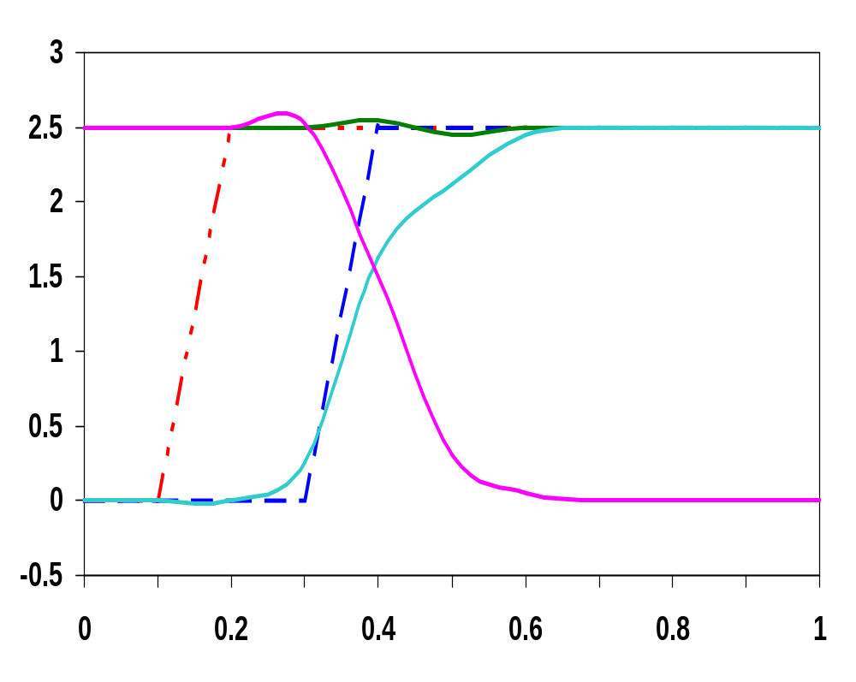
Set-up Time Simulation
Q
t_{setup} = 0.21 ns
Q_{M}
Volts
D
clk
I₂ out
works correctly
Time (ns)
Notes:
progressively skew the input wrt to the clock edge until the circuit fails.

Slide 23
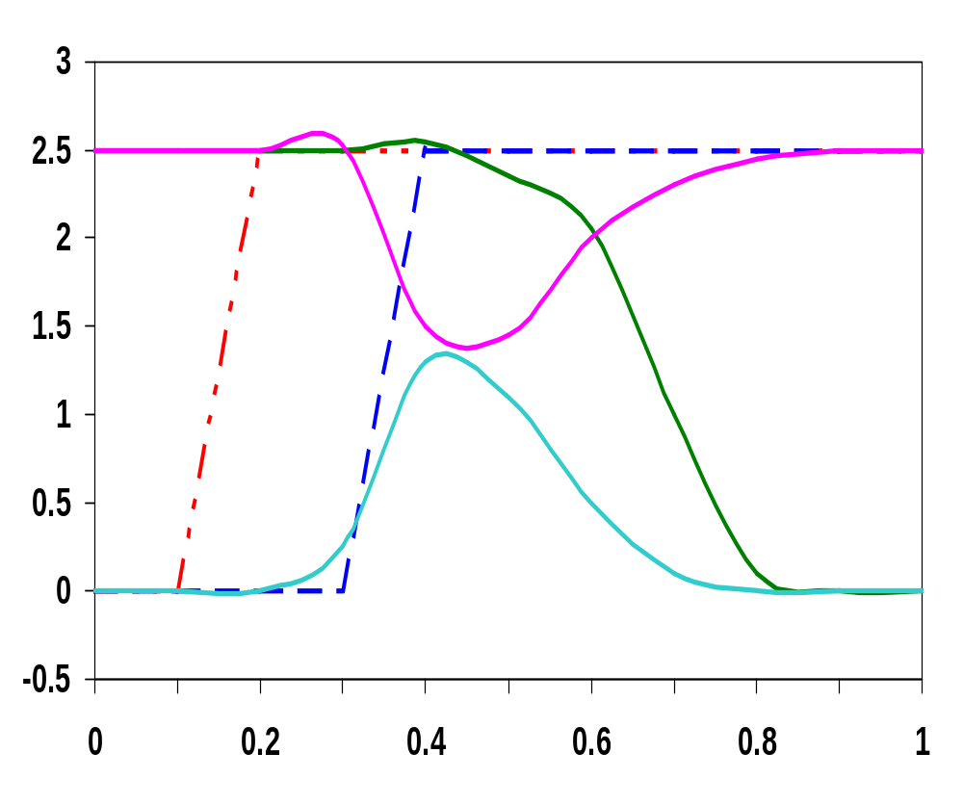
Set-up Time Simulation
Q
I₂ out
t_{setup} = 0.20 ns
Volts
D
clk
Q_{M}
fails
Time (ns)
Notes:
the clock is enabled before the nodes on both sides of the transmission gate T2 settle to the same value

Slide 24
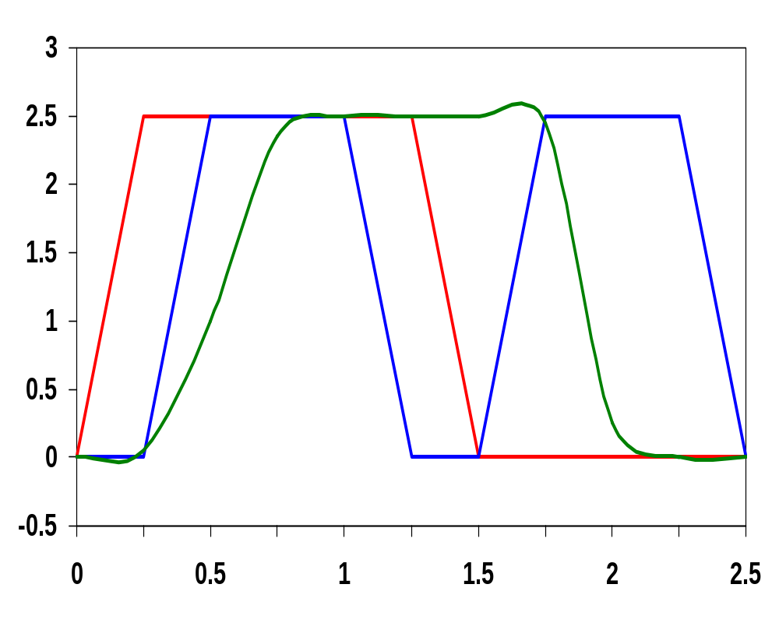
Propagation Delay Simulation
t_{c-q(LH)} = 160 psec
Volts
t_{c-q(LH)}
t_{c-q(HL)} = 180 psec
t_{c-q(HL)}
Time (ns)
Notes:
hold time - D input edge is skewed relative to the clock signal until the circuit fails
propagation delay – delay is measured from the 50% point of the clk edge to the 50% point of the Q output

Slide 25
Reduced Load MS ET FF
Clock load per register is important since it directly impacts the power dissipation of the clock network.
Can reduce the clock load (at the cost of robustness) by making the circuit ratioed
clk
!clk
I₁
I₃
Q_{M}
D
T₁
T₂
Q
I₂
I₄
!clk
clk
reverse conduction
  to switch the state of the master, T₁ must be sized to overpower I₂
  to avoid reverse conduction, I₄ must be weaker than I₁
Notes:
12 transistors with clock load of 4 (2 on clk and 2 on !clk) – but now ratioed design (and thus less robust)
T1 must overpower I2 to switch the state of the cross-coupled inverters I1 and I2. But want to use minimum (or close to it) transistors in T1 and T2 to keep clock load small (to reduce power dissipation in flipflops and in the clock distribution network). Thus, probably want to downsize the transistors in I1 (making them longer and thus weaker).
Another problem is reverse conduction is possible – second stage can affect the state of the first latch. When slave (second latch) is on, it is possible for a combination of T2 and I4 to influence the data stored in I1&I2. As long as I4 is a weak device, this is not a problem

Slide 26
Non-Ideal Clocks
clk
clk
!clk
!clk
Ideal clocks
Non-ideal clocks
clock skew
1-1 overlap
0-0 overlap
Notes:
Clk and !clk are never perfect inversions of one another – must generate !clk and route both signals (variations can exist in the wires used to route the two clock signals and load capacitances can vary)
Clock skew can result in clock overlap

Slide 27
Example of Clock Skew Problems
X
!clk
Q
clk
P₁
A
P₃
I₃
I₄
!Q
D
I₁
I₂
B
P₂
P₄
!clk
clk
Race condition – direct path from D to Q during the short time when both clk and !clk are high (1-1 overlap)
Undefined state – both B and D are driving A when clk and !clk are both high
Dynamic storage – when clk and !clk are both low (0-0 overlap)
Notes:
When clock goes high, slave should go into hold mode. But since clk and !clk are both high for a short period of time there is a direct path from D to Q. So data output could change on rising edge (not this is a negative et device!). Race condition where value of Q is a function of whether the input D arrives at node X before or after the falling edge of !clk.
Node A is driven by both D and B when clk and !clk are both high resulting in an undefined state

Slide 28
Pseudostatic Two-Phase ET FF
X
clk2
Q
clk1
P₁
A
P₃
I₃
I₄
!Q
D
I₁
I₂
B
P₂
P₄
clk2
clk1
dynamic
storage
master transparent
slave hold
clk1
master hold
slave transparent
t_{non_overlap}
clk2
Notes:
Keep clock nonoverlap time large enough that no overlap occurs even in the presence of clock skew
During the nonoverlap time, the ff is in the high-impedance state – the feedback loop is open (the loop gain is zero) and the input is disconnected. Leakage will destroy the state if this condition holds for too long – hence the name pseudostatic (the register employs a combination of static and dynamic storage approaches depending upon the state of the clock). Don’t want to stop the clocks when both are low!!

Slide 29
Two Phase Clock Generator
A
clk1
clk
B
clk2
clk
A
B
clk1
clk2

Slide 30
Power PC Flipflop
clk
!clk
1
D
Q
0
0
1
1
!clk
clk
clk
!clk
Notes:
For class handouts

Slide 31
Power PC Flipflop
clk
!clk
1
D
Q
0
→1
0
→1
1
→0
1
→0
!clk
clk
master transparent
slave hold
master hold
slave transparent
clk
!clk
Notes:
For lecture
16 transistors with a clock load of 8 (4 on clk and 4 on !clk) – fast and static

Slide 32
Ratioed CMOS Clocked SR Latch
off
on
M2
M4
Q
1
0
!Q
clk
M6
M8
clk
M1
M3
on
off
S
M7
R
1
0
M5
off
on
Notes:
For class handout

Slide 33
Ratioed CMOS Clocked SR Latch
off
→ on
on
→ off
M2
M4
Q
1
→ 0
1 ←
0
!Q
off->on
off->on
0 → 1
clk
M6
M8
clk
0 → 1
M1
M3
on
→ off
off
→ on
S
M7
R
1
0
M5
off
on
Notes:
For lecture - 8 transistor SR level sensitive latch - two clock loads (sized)
No static power consumption, but …
Ratioed device where sizing is critical to ensure proper functionality
For the case shown, M7 and M8 must succeed in bringing Q low (overcoming M4) - below the threshold of M1
Therefore, must increase the sizes of transistors M5,M6,M7, and M8

Slide 34
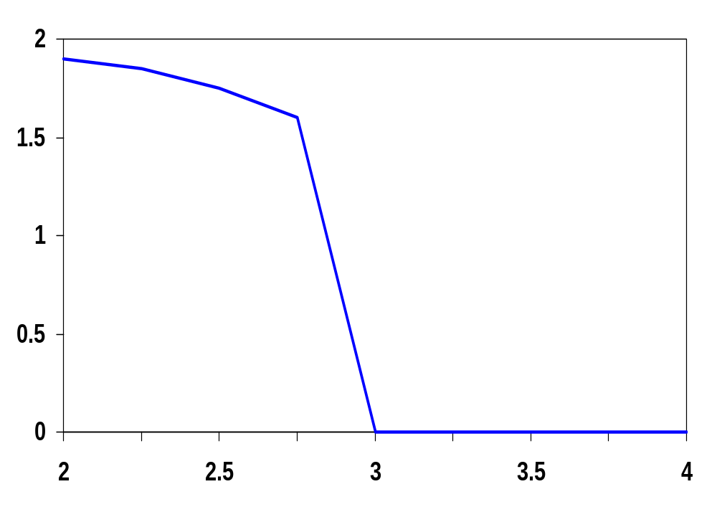
Sizing Issues
so W/L_{5and6} > 3
!Q (Volts)
W/L_{5and6}
W/L_{2and4} = 1.5μm/0.25 μm
W/L_{1and3} = 0.5μm/0.25 μm
Notes:
Want VM at Vdd/2
Assuming Q=0, determine the minimum sizes of M5, M6, M7, and M8 to make the device switchable
so the individual device ration for M5 or M6 must be larger than approx. 6. Analysis results give 2.26 (instead of 3) since it doesn’t take into account channel length modulation and DIBL (drain induced barrier loading).

Slide 35
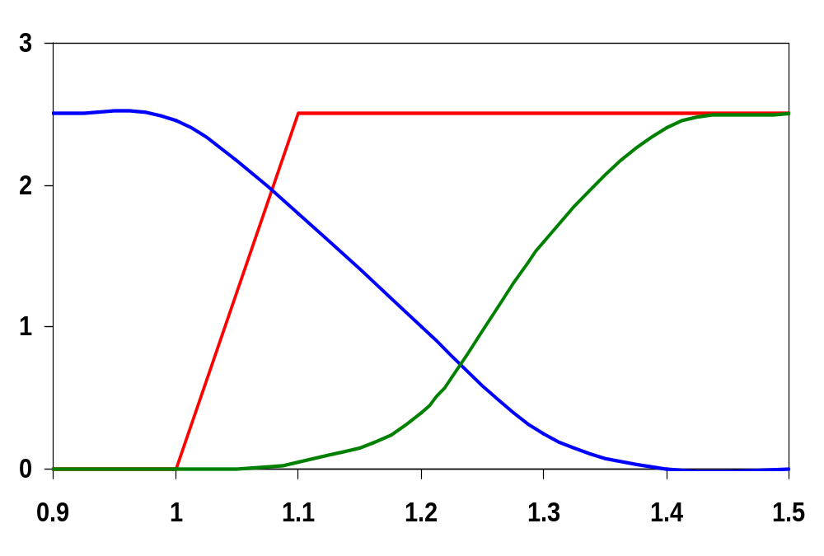
Transient Response
SET
!Q
Q & !Q (Volts)
Q
t_{c-!Q}
t_{c-Q}
Time (ns)
Notes:
tp!Q = 120 psec
tpQ = 230 psec

Slide 36
6 Transistor CMOS SR Latch
clk
clk
R
S
clk
clk
M2
M4
Q
M6
S
M5
!Q
R
M1
M3
Notes:
Problems with noise margins and static power consumption due to threshold drop across pass transistors
Once again, sizing is important - especially M5 and M6
Will see this structure again when we talk about SRAMs!!

Slide 37
Next Lecture and Reminders
Next lecture
  Dynamic sequential circuits
    Reading assignment – Rabaey, et al, 7.3, 7.7
Reminders
  Project prototypes due today
  Project final reports due December 5th
  HW4 due November 5th
  HW5 out November 5th and due November 19th
  Final exam scheduled
    Monday, December 16th from 10:10 to noon in TBD

